Slide 1
Developing a State-of-the-Art Question-Answering Model
Dec 24th, 2024
Indigo

Slide 2
Problem Statement
Objective: Develop an AI system capable of understanding and generating accurate responses to user queries using the Quora Question Answer Dataset.
Key Findings:
Create an interactive, human-like question-answering model.
Use state-of-the-art models like GPT-2 and evaluate using robust NLP metrics.

Slide 3

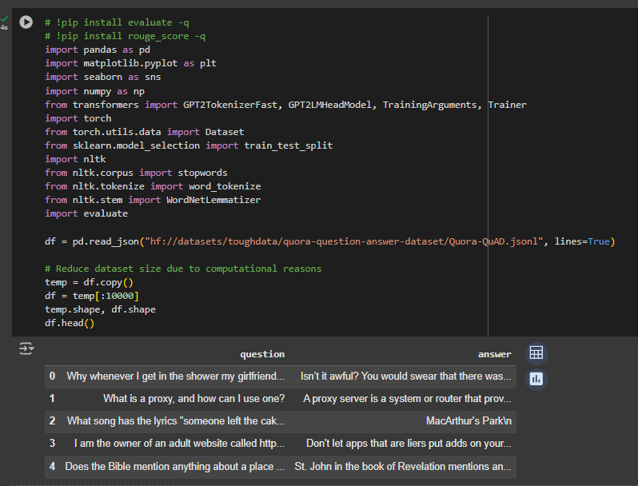
Dataset Overview
Dataset Source: HuggingFace Dataset - Quora Question Answer Dataset.
Dataset Structure:
Total Rows: 56,402
Features: question, answer
Initial Observations:
Clean and well-structured dataset
Some rows with missing/duplicate values (handled during preprocessing)
We had to reduce the dataset to 5000 rows due to computational resources.

Slide 4
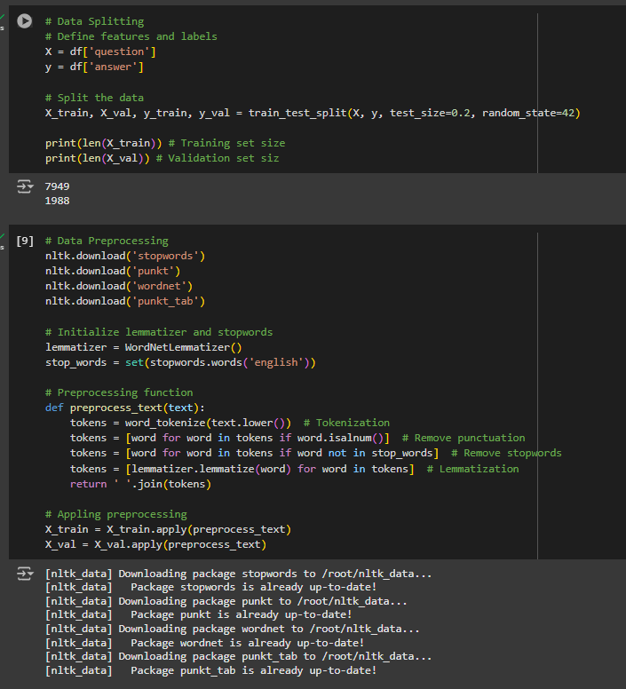
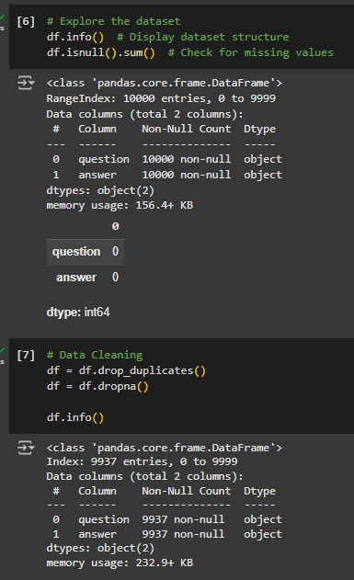
Data Cleaning and Preprocessing
Data Cleaning: Removed duplicates and handled missing values.
Preprocessing: Tokenization, Stop-word removal and Lemmatization
Tools Used:
NLTK (Natural Language Toolkit) for tokenization and lemmatization
Python Pandas for data manipulation

Slide 5
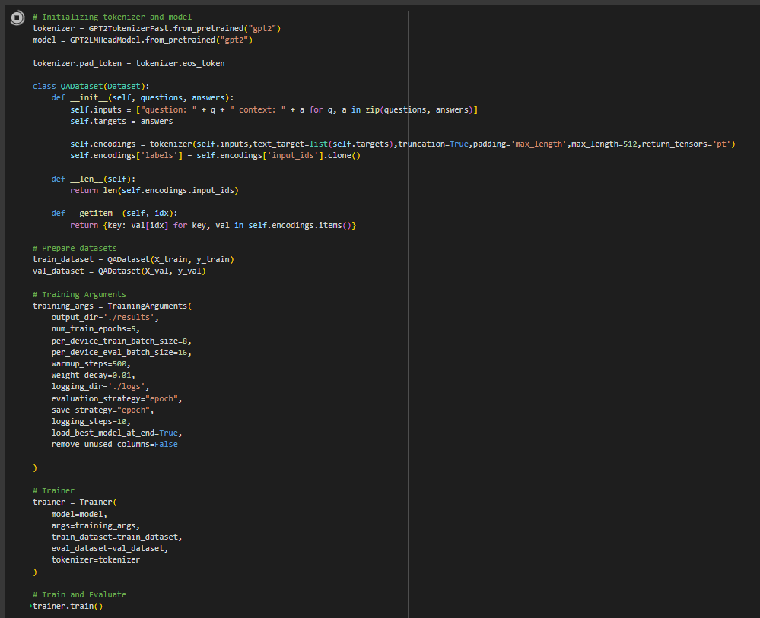
Model Selection and Architecture
Model Used: GPT-2 (Generative Pretrained Transformer 2)
Why GPT-2?
Proven state-of-the-art performance in text generation tasks.
Flexible and effective for fine-tuning on smaller datasets.
Training Details:
Epochs: 5
Batch Size: 8
Epoch-level validation during training
Due to shortage of resources, we have reduced the dataset. Moreover, there can be further enhancements for experimentation - which was again a blocker due to computational resources.

Slide 6
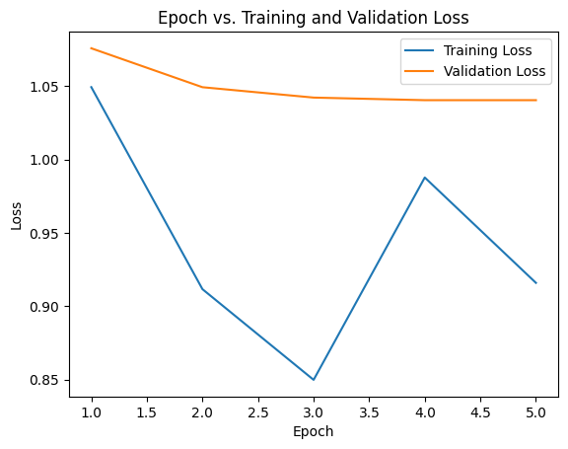
Model Evaluation Metrics
Evaluation Metrics:
ROUGE (Recall-Oriented Understudy for Gisting Evaluation): Measures the quality of generated text by comparing it to a reference answer.
BLEU (Bilingual Evaluation Understudy): Measures the precision of n-grams (overlap) between generated and reference text.

Slide 7
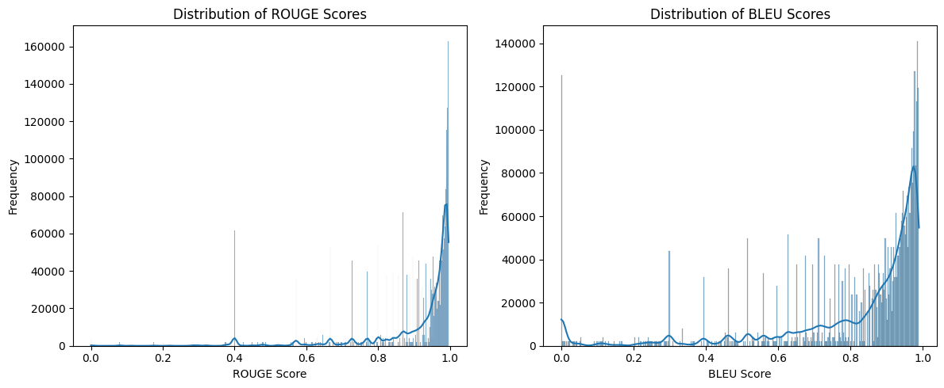
ROGUE and BLEU scores
ROUGE and BLEU scores centered around 0.9, showing high-quality outputs.

Slide 8
Recommendation and Insights

Slide 9

Insights: What we saw?
GPT-2 effectively captured the context and generated coherent, relevant answers.
The model showed strong alignment with reference answers based on ROUGE and BLEU metrics.

Slide 10
Recommendations
Explore larger models (e.g., GPT-3) for better accuracy.
Investigate multi-task learning for domain adaptability.
Test robustness with real-world datasets.

Slide 11
Github Link

Slide 12

Thank You

